Slide 1


Slide 2
Core Operating Gifts (COGs) are the fundamental building blocks that make up the human experience, influencing our thoughts, reactions, and interactions.
Alignment
Purpose
Insights
Strategic Thinking
Communicate
Expression
Relationships
Empathy
Leadership
Confidence
Adaptability
Creativity
Stability
Security

Slide 3
Core Operating Gifts (COGs) are the fundamental building blocks that make up the human experience, influencing our thoughts, reactions, and interactions.
Core Operating Gift (COGs) – An innate skill within an individual that governs how a person operates, processes information and emotions, driving functional behavior patterns and daily habits. Collectively with other COGs, they form the multi dimensional talents, often considered soft skills, that forms the identity and personality of an individual.
Core Operating Gift (COGs)
Manifestation
Core
Skill
Manifestation – This is how the skill is applied, “shows up”, in the real work through interactions, situations, the environment, and/or opportunity
Core Skill – A foundational talent / gift that exists with the individual that may or may not be visible to others. The strength of the foundational core skill will vary by individual based on their level of awareness and subsequent development of the talent as they may or may not be aware that this innate talent exists within themselves.
Manifestation
Core
Skill
Leading Core Operating Gift (LCOGs) – An innate skill within an individual that comes natural to the individual. The strength if the talent is naturally strong and the individual usually has some level of awareness of the skill at an early age. This leading skill shines through the individual effortlessly and forms the basis of the personality and how the other COGs interact with one another.

Slide 4
EXAMPLE
Core Operating Gifts (COGs) are the fundamental building blocks that make up the human experience, influencing our thoughts, reactions, and interactions.
Core Operating Gift (COGs) – An innate skill within an individual that governs how a person operates, processes information and emotions, driving functional behavior patterns and daily habits. Collectively with other COGs, they form the multi dimensional talents, often considered soft skills, that forms the identity and personality of an individual.
Core Operating Gift (COGs)
Stability
Security
Manifestation – This will show up as an individual looks and feels put together. There is a sense of the person’s identity that is visible to others.
Core Skill – The skill of have a sense of security deals with one's level of grounded-ness in oneself. There is an awareness of what safety feels like within themselves and/or through close relationships.
Manifestation
Core
Skill
Leading Core Operating Gift (LCOGs) – An innate skill within an individual that comes natural to the individual. The strength if the talent is naturally strong and the individual usually has some level of awareness of the skill at an early age. This leading skill shines through the individual effortlessly and forms the basis of the personality and how the other COGs interact with one another.

Slide 5
EXAMPLE
Core Operating Gifts (COGs) are the fundamental building blocks that make up the human experience, influencing our thoughts, reactions, and interactions.
Responsible → Stewardship
Initiative <-- Supportive
Leadership
Confidence
Inspirational → Aspiration
Community<-- Contextual
Personal → Credibility
Relational → Trust
Manifestation
Core
Skill
Leading Core Operating Gift (LCOGs) – An innate skill within an individual that comes natural to the individual. The strength if the talent is naturally strong and the individual usually has some level of awareness of the skill at an early age. This leading skill shines through the individual effortlessly and forms the basis of the personality and how the other COGs interact with one another.

Slide 6
Purpose
&
Alignment
I felt a clear connection to my work’s larger purpose.
I reflected meaningfully on my long-term path.
My values were aligned with my decisions in that moment.
I felt a sense of peace or fulfillment regardless of the outcome.
Confidence
&
Leadership
I felt confident in expressing my point of view.
I handled the situation with composure and control.
I took initiative without relying heavily on others.
I felt empowered and aligned with my role.
Empathy
&
Relationships
I recognized the emotions the other person was experiencing.
I responded with empathy and emotional intelligence.
I maintained trust in the relationship despite the issue.
I felt emotionally connected to my team afterward.
Creativity
&
Adaptability
I stayed emotionally balanced as the change unfolded.
I accessed creative solutions to move forward.
I was open to new approaches without resistance.
I felt emotionally connected to the work/team during the change.
Insights
&
Strategic Thinking
I trusted my intuition in addition to logical reasoning.
I had a clear vision of potential long-term impacts.
I stayed mentally focused and avoided overthinking.
I felt confident in the clarity of my decision.
Security
&
Stability
I was aware of my emotional reaction in the moment.
I remained calm and focused despite the disruption.
I took action or sought clarity to restore my sense of security.
I felt psychologically safe within my organization.
Communication &
Expression
I clearly expressed my thoughts and feelings.
I listened to the other person’s perspective actively.
I adjusted my tone or delivery to maintain respect.
I felt understood and heard by others.

Slide 7
These core emotion centers (CEC) are fundamental to the human experience, influencing our thoughts, reactions, and interactions.
Purpose
&
Alignment
Purpose
&
Alignment
Insights
&
Strategic Thinking
Communication &
Expression
Insights
&
Strategic Thinking
Communication &
Expression
13 %
Empathy
&
Relationships
Empathy
&
Relationships
13 %
13 %
Confidence
&
Leadership
Creativity
&
Adaptability
Confidence
&
Leadership
Creativity
&
Adaptability
22 %
Security
&
Stability
Security
&
Stability
13 %
13 %
13 %

Slide 8
COG Capture Work-Flow
Engage AI Conversation agent
Engage AI
Voice/Tone
Agent
Engage AI
COG
agent
Engage AI
Listening
Agent
Engage AI
Visual/Video
Agent
As each question is answered, The COG Agent visually populates each dimension of the COG in a green Color and % complete
Conversation Agent:
Hi, Lets get started. I’m going to ask you a series of questions. Don’t worry, this is not a test. There is no right or wrong answer. These questions will help me get a better understanding of you and your Core Operating Gifts.
Are you comfortable with your camera being on?
Response:
Ready?
Response:
Tell me about a stressful time in your life?
Response: {video or audio response from individual}

Slide 9


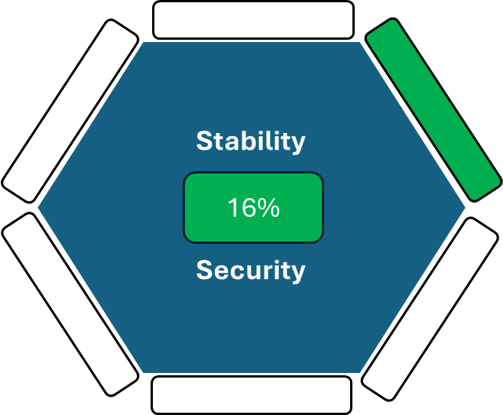



Tell me about a stressful time in your life?
Thanks, lets continue
Hi, Lets get started

Slide 10
Core Operating Gifts (COGs) of Security & Stability
1
Notice Their Reaction to Failure or Criticism
Ask the following questions as a conversational piece while assessing communication style
Tell me about your oldest friend. What makes that relationship special?
Tell me about an experience where you felt you learned a lesson? What was your biggest takeaway?
Tell me about a time when you told someone no?
Tell me about a stressful time in your life?
1
Security & Stability
Self-Responsibility
Emotional Regulation
4
3
Look for Healthy Boundaries
1
Watch for Authenticity
2
2
2
Evaluate Their Relationships
3
4

Slide 11
Core Operating Gifts (COGs) of Security & Stability
Notice Their Reaction to Failure or Criticism
Ask the following questions as a conversational piece while assessing communication style
Tell me about your oldest friend. What makes that relationship special?
Tell me about an experience where you felt you learned a lesson? What was your biggest takeaway?
Tell me about a time when you told someone no?
Tell me about a stressful time in your life?
Self-Responsibility
Stability
Security
Emotional Regulation
4
16%
1
Watch for Authenticity
2
Look for Healthy Boundaries
Evaluate Their Relationships
3

Slide 12
Conversation Agent:
Hi, Lets get started.
I’m going to ask you a series of questions. Don’t worry, this is not a test. There is no right or wrong answer. These questions will help me get a better understanding of you and your Core Operating Gifts.
Are you comfortable with your camera being on. ?
Response:
Ready?
Response:
Tell me about a stressful time in your life?
Response: {video or audio response from individual}

